Slide 1
jQUERY DOM MANIPULATION

Slide 2
DOM handling -jQuery

Slide 3
Document Object Model (DOM)
The W3C Document Object Model(DOM) is a platform and language-neutral interface that allows programs and scripts to dynamically access and update the content, structure and style of a document .
jQuery provides multiple methods to manipulate DOM.
Using these methods it is easy to access and manipulate elements and attributes.
It also provides methods to change browser window dimensions.

Slide 4
DOM APIs
Selector | Description
$(selector).text(); | Sets or returns text content of selected elements
$(selector).html(); | Sets or returns content of selected elements(including HTML mark-up)
$(selector).val(); | Sets or return the value of form fields

Slide 5
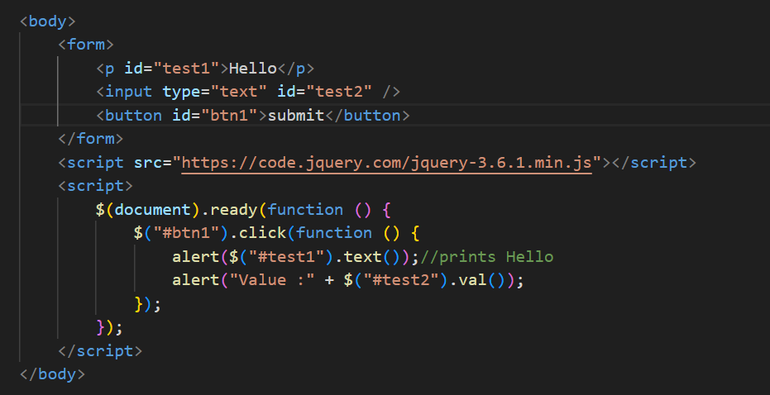
Example usage-Getting values using DOM APIs

Slide 6
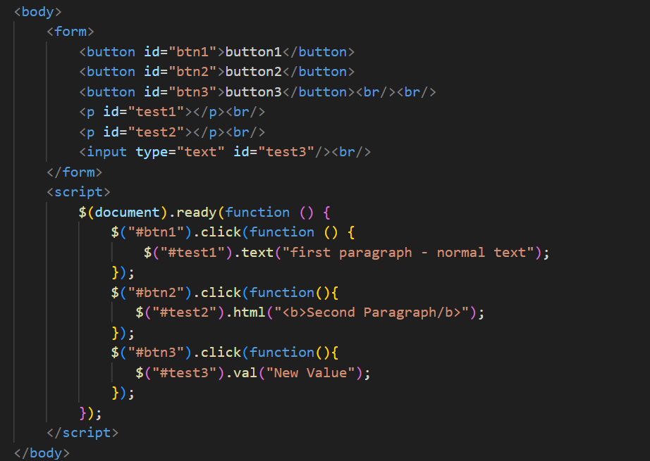
Example usage-Setting values using DOM APIs

Slide 7
DOM APIs – Insert and Remove
Selector | Description
$(selector).append(); | inserts specified content at the end of the selected elements.
$(selector).prepend(); | inserts specified content at the beginning of the selected elements
$(selector).after(); | inserts specified content after the selected elements.
$(selector).before(); | inserts specified content in before the selected elements.
$(selector).remove(); | remove() method removes the selected element(s) and its child elements.
$(selector).empty(); | removes all child nodes and content from the selected elements.

Slide 8
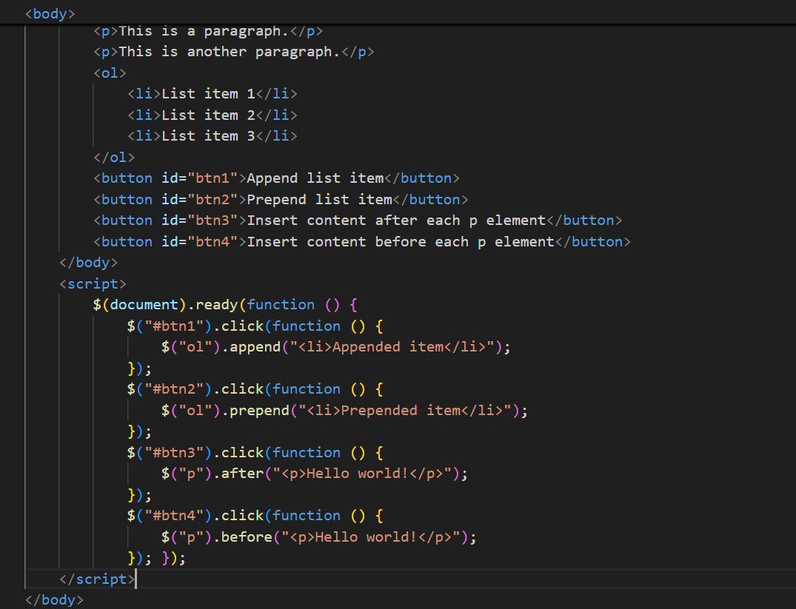
Example usage - Insert and Remove

Slide 9
DOM APIs-Handling styles
Selector and description
$(selector).css({“property”:”value”, “property”:”value”,……});
Example
$(“p”).css(“background-color"," green”);
$(“p).css({“background-color”,”orange”,”color”:”white”});

Slide 10
jQuery Dimension APIs
Selector | Description
$(selector).width(); | sets or returns the width of the selected elements(excludes padding,border and margin).
$(selector).height(); | sets or returns the height of the selected elements(excludes padding,border and margin).
$(selector).innerWidth(); | returns the width of the first matched element(includes padding).
$(selector).innerHeight(); | returns the height of the first matched element(includes padding).
$(selector).outerWidth(); | returns the width of an element(includes padding and border).
$(selector).outerHeight(); | returns the height of an element(includes padding and border).

Slide 11
DOM Traversal -jQuery

Slide 12
What is DOM traversal?
DOM is organized in a tree structure where each node has parent and child nodes.
Typically leaf nodes contains the resources(ex- Text/images)
We can find / select single or multiple DOM nodes based on the selector tag provided to jQuery.

Slide 13
DOM Tree Terminology
To understand the tree structure and manipulate using jQuery few terminology need to be understood with respect to a particular node.
Move up to find ancestors.
Move down to find Descendants.
Move sideways to find Siblings.

Slide 14
div
<div>
div
<ul>
Element | Relationship Information
<div> | Ancestor of all
<li> | Parent of <span> child of <ul> and descendants of <div>
<li><li> | siblings
div
<li>li>iv
<li>
<<span>
<span>
<span>

Slide 15
jQuery Api Traversing
Selector | Description
$(selector).parent(); | It returns the direct parent element of the selected element.By passing an optional parameters it will return parent of that type(ex-parent(“ul”))
$(selector).parents(); | It returns all ancestor elements of the selected element all the way up to the document’s root element(<html>)
$(selector).parentsUntil(); | Returns all ancestor elements between two given arguments.

Slide 16
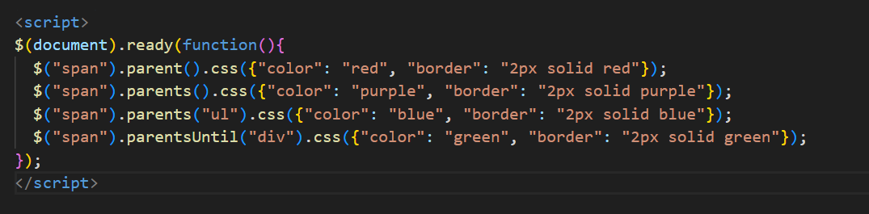
Example Usage – Parents Traversing

Slide 17
jQuery APIs – Siblings Traversal
Selector | Description
$(selector).siblings(); | returns all sibling elements of the selected element.
$(selector).next(); | returns next sibling elements of the selected element.
$(selector).nextAll(); | returns all next sibling elements of the selected element.
$(selector).nextUntil(); | returns all next sibling elements between two given arguments.
$(selector).prev(); | returns previous sibling elements of the selected element.
$(selector).prevAll(); | returns all previous sibling elements of the selected element.
$(selector).prevUntil(); | returns all previous sibling elements between two given arguments.

Slide 18
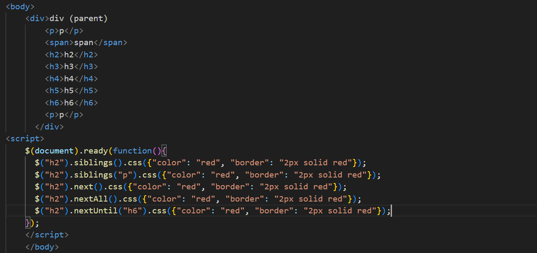
Example Usage – Siblings Traversing

Slide 19
jQuery APIs –Filtering
Selector | Description
$(selector).first(); | returns the first element of the specified elements.
$(selector).last(); | returns the last element of the specified elements.
$(selector).eq(); | returns an element with a specific index number of the selected elements.
$(selector).filter(); | lets you specify a criteria. Elements that do not match the criteria are removed from the selection, and those that match will be returned.
$(selector).not(); | returns all elements that do not match the criteria.

Slide 20
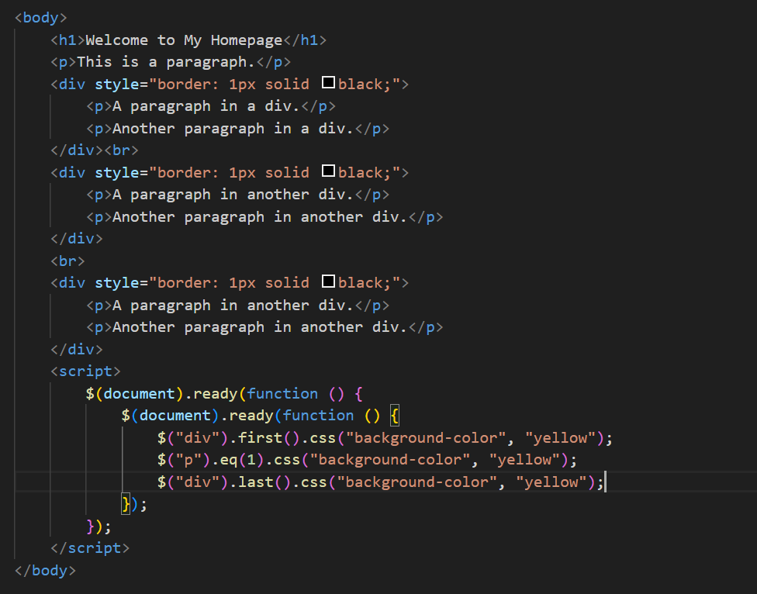
Example Usage – Filtering

Slide 21

Thank You

